Slide 1
Sentiment Analysis of Financial Statements
Christian Ekwomadu
David Blankenship
Jai Vaidya
Nana Afua Martinson

Slide 2
Meet Our Team
Christian Ekwomadu
Interests: Machine Learning, Data Analysis and Cloud Computing
Background: Last Quarter MSDS with a Bachelors in Management Information System. Previous Experience as a Data Science co-op at BGE
David Blankenship
Interests: Application of AI/ML, Generative AI, NLP
Background: 3rd quarter MSDS student with a Bachelors in Astrophysics. Prior Navy Officer in a highly technical field, now a veteran transitioning to a new civilian career.
Jai Vaidya
Interests: Machine Learning, Neural Network, NLP
Background: 2nd quarter MSDS student with Bachelors in Statistics with professional experience in Data Analytics
Nana Afua Martinson
Interests: Machine Learning, Business Intelligence, Data Analysis
Background: Last but one quarter MSDS with a background in the Healthcare and Pharmaceutical Industry

Slide 3
Project Goal
The goal for our project was be to take the finance phrasebank data put together by Malo et al. and develop a deep learning/neural network pipeline to classify the sentiment of the sentences in the dataset. The goal was to benchmark our results against the results of Malo et al., particularly the LPS method they developed.
The NLP task we used in this project was sentiment analysis in which we attempt to classify different sentences as positive, negative, or neutral.

Slide 4
Good Debt or Bad Debt: Detecting Semantic Orientation in Economic Texts
Our data set is the financial phrasebank dataset available on huggingface at the following url: https://huggingface.co/datasets/financial_phrasebank.
The dataset consists of ~5000 sentences with a corresponding label of sentiment (positive, negative, or neutral). Malo et al. had 16 annotators, vetted for domain knowledge, review finance news sentences for positive, negative, and neutral sentiment.
The data was collected from web-scraping, pre-processed to include only sentences including relevant language (finance phrases directionality of sentiment, etc), and then randomly sampled down to the ~5000 sentence dataset. It is further broken up by percentage of agreement; 100%, 75%, 66%, 50%.

Slide 5
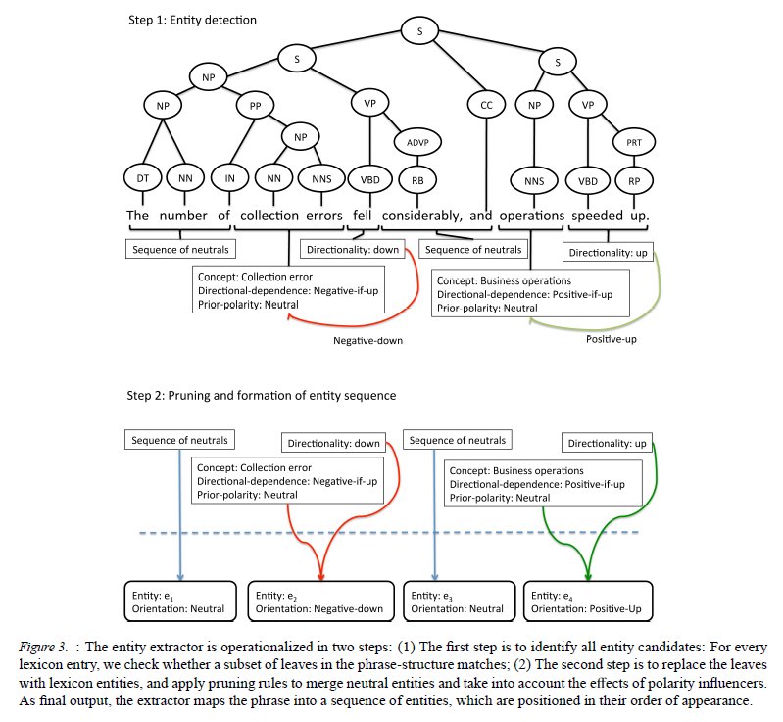
Good Debt or Bad Debt: Detecting Semantic Orientation in Economic Texts
For their analysis Malo et al. added extra context to the sentences by breaking them into entities, orientations and directionality features with additional rules for how they all interact.
They called this the Linearized-Phrase Structure (LPS) Model and it was developed to allow them to quantify portions in the sentence to determine the overall semantic orientation (positive, negative, or neutral).

Slide 6
GloVe Premade Word Vectors
In addition to the financial phrasebank data we used premade GloVe word vectors to embed our sentences.
We used the 6B token model with 50, 100, 200, and 300 dimensions.
It is available here: https://nlp.stanford.edu/projects/glove/

Slide 7
Data Pre-Processing
The initial phrasebank data is in the following form:
According to Gran , the company has no plans to move all production to Russia , although that is where the company is growing .@neutral
We split the data at the @ symbol, tokenize the data, and turn the sentiment labels into categorical labels 0, 1 and 2.
We then create a vocab with an unknown and padding token and encode sequences padded out to the max sentence length in our dataset. We also turn these into tensors and split the data into a Train, Validate, and Test split
Finally, we create an embedding matrix for use in the Neural Network. Unknown words have randomly generated vectors.

Slide 8
Neural Methodology
We attempted two methods for our neural methodology
A Sequence-to-Sequence Encoder - Decoder model with GRU hidden layers
The encoder is a bidirectional GRU
The GRU layers when greater than 1 have dropout
The decoder is a unidirectional GRU
The GRU layers when greater than 1 and output layers have dropout
A basic bidirectional GRU with dropout
Both use the sequences from our preprocessing
Both methods have word vector embeddings from GloVe
Our training included both a learning rate and gradient clipping
We use cross entropy loss and an Adam optimizer

Slide 9
Neural Methodology (contd)
Encoder-Decoder
hidden_size = 81
gru_layers = 2
dropout = 0.75
batch_size = 32
lr=0.01
epochs=20
clip=0.9
Basic Model
hidden_size = 81
gru_layers = 1
dropout = 0.1
batch_size = 32
lr=0.01
epochs=20
clip=0.9

Slide 10
Project Baseline
The baselines we intended to use were the results in tables 4 and 5 of Malo et al. showing the accuracy, recall, precision, and F1-score of 5 different models for the dataset (shown in the next slide).
We also intended to compare the results for the 4 different percentages of annotator agreement, those being 100%, 75%, 66%, and 50% agreement.

Slide 11
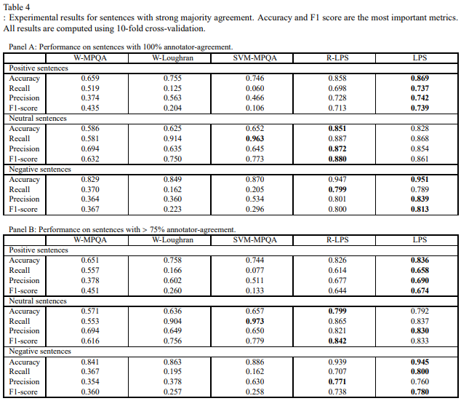
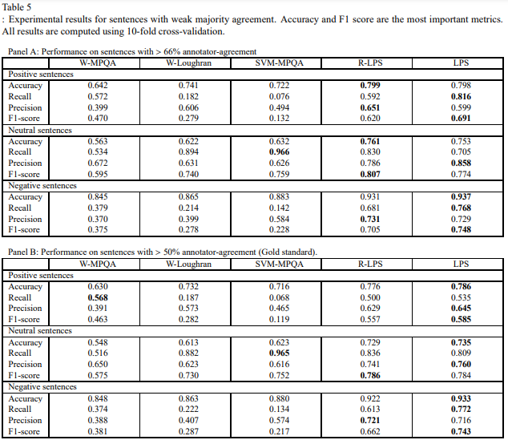
Project Baseline (contd.)

Slide 12
Our Results
Ultimately, we were unable to create a meaningful model that was able to seriously replicate or improve upon the results of Malo et al.
We outline several issues we ran into below:
A very poor ability to predict neutral sentences.
Our model is technically capable of predicting neutral as we occasionally saw runs with 1.0 precision, but 0.01 recall for neutral, suggesting one or a few data points were labelled neutral.
Practically, however it was almost always no predications
Exploding gradient even with very high gradient clipping.
A tendency of our Encoder-Decoder to occasionally classify everything as positive
In particular our final runs for this model it was completely unable to classify anything but positive.
Extreme swings in values between runs even with the same hyperparameters

Slide 13
Our Results (contd)
A few other trends that we saw included:
The Basic model was significantly more consistent when compared against the encoder-decoder method and was generally able to separate positive and negative results.
The neutrals would be separated into either positive or negative bringing down the precision scores. As such precision was consistently lower than recall
Occasionally we would even see very high or even perfect recall scores.
Strictly speaking we do get competitive recall for positive and negative sentences.
Word vector dimensionality and annotator agreement rates don’t seem to make much if any impact to our results.
This is hard to say for certain due to the difficulty in assessing what better is in our results as we show on the next slide.

Slide 14
What is Best?
Below we show the results from the basic model for the 50 dim word vector and 200 dim word vector both where all annotators agrees. Both results are overall not very good since they fail to predict an entire category. There is also the question of whether recall or precision is more important when the model is failing as much as in this case. It simply isn’t clear what best is in this case.
50dim | Precision | Recall | F1
Negative | 0.87 | 0.73 | 0.80
Neutral | 0.00 | 0.00 | 0.00
Positive | 0.28 | 1.00 | 0.44
200dim | Precision | Recall | F1
Negative | 0.51 | 0.98 | 0.67
Neutral | 0.00 | 0.00 | 0.00
Positive | 0.31 | 0.93 | 0.47

Slide 15
Why the Divergence?
We quote Malo et al below
When examining category specific agreements, we find a very high agreement (98.7%) for separating positive and negative sentences from each other. There is also a strong consensus (94.2%) for distinguishing neutral sentences from negative ones. However, separating positive sentences from neutral sentences appears to be more challenging, which is reflected as a lower average pairwise agreement (75.2%). This finding is somewhat predictable, since making a difference between commonly used company glitter and actual positive statements is not an easy job.
Malo et al's paper was largely about getting around the fact that many of these phrases have every intention of sounding as positive as possible.
Even outside of that many of the neutral and even negative sentences may use the same words as the positive ones. For example, “reduced profits” vs “reduced errors” both use “reduced” but have totally different connotations. The LPS method captures this with its rules, our method did not. Unfortunately, these were not provided in the original dataset.
We note that we also do see that it is much easier to separate negative and positive sentences in our results as well.

Slide 16
Conclusion
Ultimately, we were unable to replicate or improve upon the results of Malo et al due to the various issues we have outlined within this presentation. We suspect that in order to improve upon the model that we developed a serious rework would be required adding additional information just as was done in the original paper.

Slide 17
Future Scope
We had hoped to implement an attention-based version of our encoder-decoder but were unable to implement it in time.
Frankly, we remain skeptical that this model would see improved results due to the reasons we have already outlined without significant rework in the data preprocessing.
One possible way to improve our model would be to encode the phrasebank data with the same entity and directionality information as in Malo et al.
Trying this model on a binary sentiment dataset or one that has less incentive to obscure the actual nature of the data such as reviews by customers.

Slide 18
Split of Work
As team members we worked together on all portions, however we divided into 4 main areas of responsibility.
Christian
Training
David
Neural Methodology
Nana
Evaluation
Jai
Preprocessing
Notes:
Can be brief

Slide 19
Bibliography
Malo, Pekka, et al. (2013). Good Debt or Bad Debt: Detecting Semantic Orientations in Economic Texts - https://arxiv.org/pdf/1307.5336
Wiebe, J., Wilson, T., & Cardie, C., (2005). Annotating Expressions of Opinions and Emotions in Language. Language Resources and Evaluation, 39, 165-210.
Pang, Lee., & Vaithyanathan (2002). Thumbs up? Sentiment Classification using Machine Learning Techniques - https://arxiv.org/pdf/cs/0205070
Loughran., & McDonald∗ (2011). When Is a Liability Not a Liability? Textual Analysis, Dictionaries, and 10-Ks - https://www.uts.edu.au/sites/default/files/ADG_Cons2015_Loughran%20McDonald%20JE%202011.pdf
Tetlock, P. (2007). Giving content to investor sentiment: The role of media in the stock market. Journal of Finance, 62, 1139–1168.
Notes:
Just introduce don’t need to go through them

Slide 20
Thank You

